Slide 1
Overview: Get fit website is an interactive website that provide users with the opportunity to purchase fits equipment. In our world that is driven with tech today, the idea of going to physical shop to search for fits equipment to buy has gone into extinction and everybody wants their presence known online now, so it’s easier for potential customers who are everywhere on the internet to reach you via an online platform like get fit website. The get fit website other than potential customers contacting you, also give opportunities to as many as possible to read about all the equipment on the website.

Slide 2
Research and planning: The get fit website is created for users who will want to contact us for some of our services, a lot of people may be rendering the same services as ours but having access to all our information via the get fit website makes life easier for our customers and potential customers. To start with its development HTML5, CSS and Javascript was used. To create a web application that is both functional on a desktop and a mobile device all CSS responsive rules was observed during the development.

Slide 3
HTML5: HTML 5 version was used in this web application; HTML 5 is a revision of the Hypertext Markup Language (HTML), the standard programming language for describing the contents and appearance of web pages. HTML5 was developed to solve compatibility problems that affect the standard of HTML 4. HTML 5 provides one common interface to make loading element easier. For example, there is no need to install a flash plugin in HTML5 because the element will run by itself.

Slide 4
Javascript: Javascript is a scripting language that allows you to implement complex features on web pages – every time a web page does more than just sit there and display static information for you to look at displaying timely content updates, interactive maps, animated 2D/3D graphics, scrolling video jukeboxes, etc. You can bet that Javascript is most likely involved. It is the third layer of the layer cake of standard web technologies. Javascript is a scripting language that enables you to create dynamically updating content, control multimedia, animate images, and pretty much everything else. Hence Javascript was used to make get fit website interactive.

Slide 5
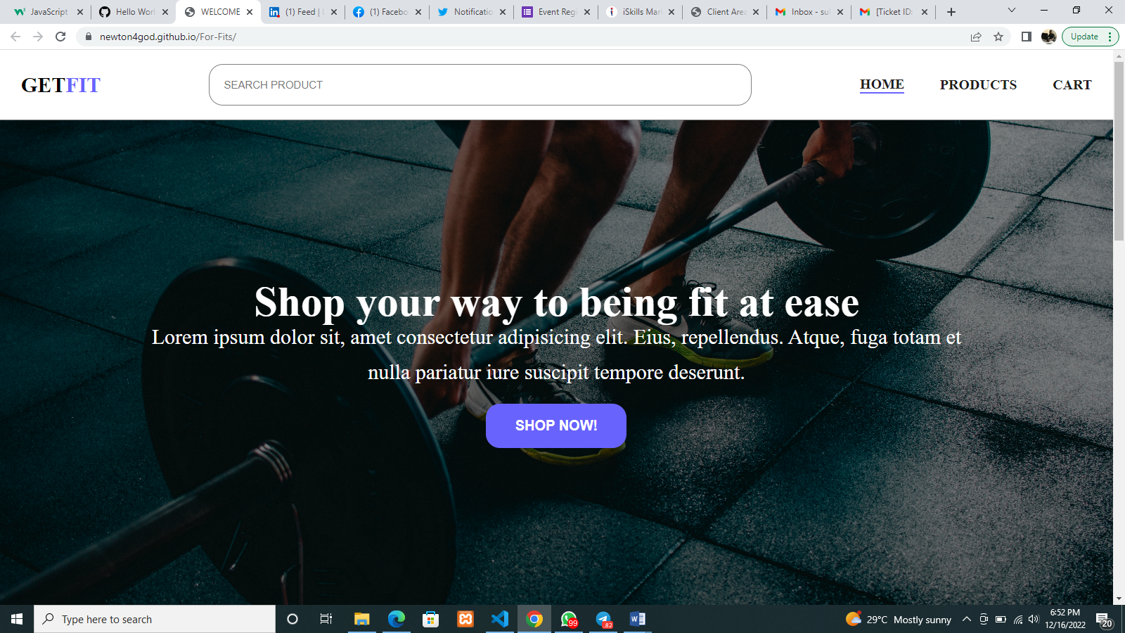

Slide 6
Homepage: The home page introduces the user and display other pages, to help the users navigate around the web pages. The home page also, is the first page that will open when you visit the website, hence I have “Shop your way to being fit at ease” on it to welcome my users, it also contains a call to action button to help my users if they decide to purchase any of our items. The homepage also contains a search bar where users can easily search for the product that is not displayed on my products page, which make it easier for the client to easily search for any product even before getting to the products page.

Slide 7
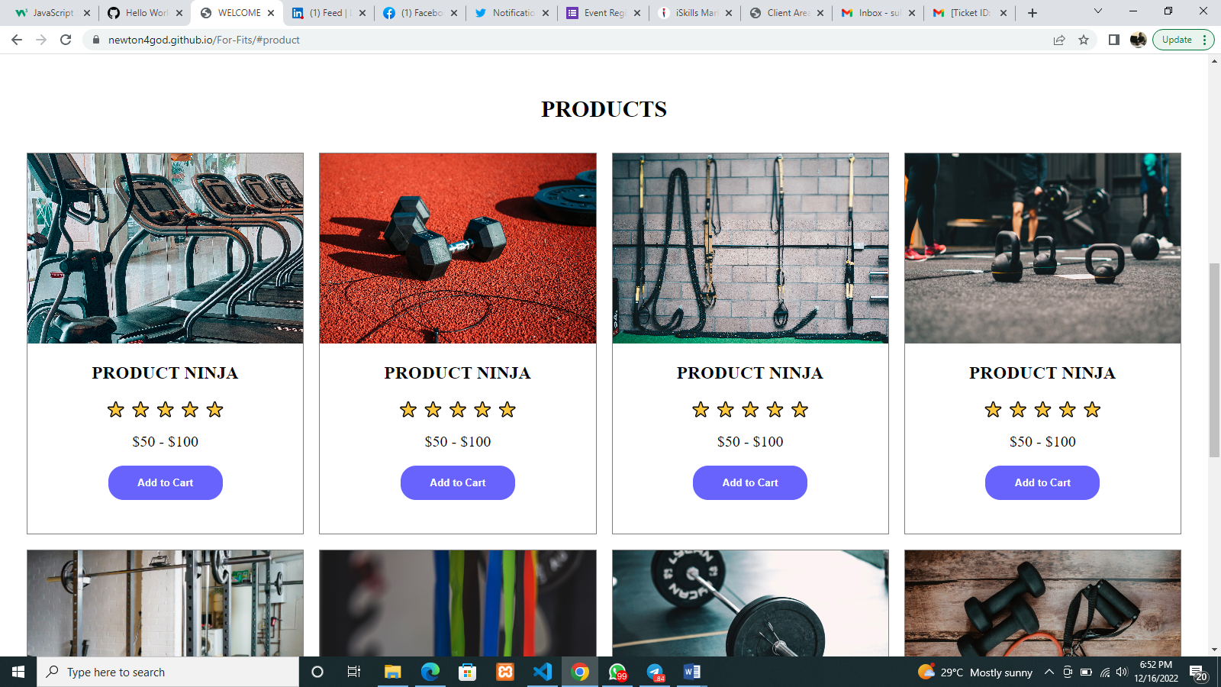

Slide 8
Products page: The products page contains some of our products display perfectly to help our users with decision. A user can easily scroll through to see our products and may be a good way to start with decision, and also our users can feed their eyes with beautifully placed fit equipment.

Slide 9
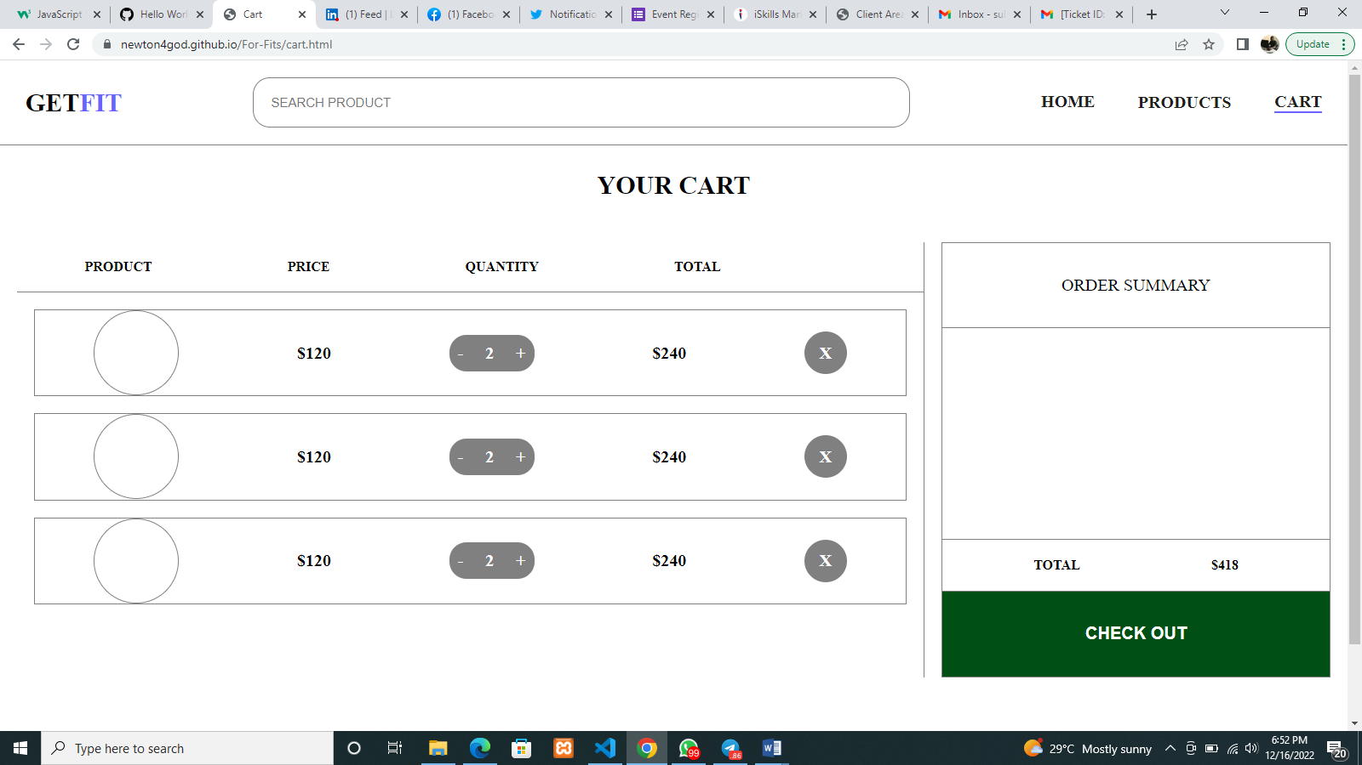

Slide 10
Cart: Our cart page provides an access to select the number of equipment that our users decide to purchase. The user doesn’t stress much as the product images are placed side by side with the price, quantity and total, to sum the amount of products selected. This page also carries the checkout button which mean you can pay immediately after you finish shopping your fit equipment.

Slide 11
Thank you for listening

